Slide 1
Churn Management Program
Capstone Presentation
Jake Daniels
August 8th, 2018
https://github.com/imjakedaniels/ryersoncapstone

Slide 2
Objective of Churn Management Program
Offer proactive incentives - ex. rebates - aimed to retain would-be churners predicted by a classification model with an ideal mix of low FPR and high Lift

Slide 3
Prep Tables & Load AWS Server
Dimensionality Reduction and Exploratory Analysis
Enforcing Churn Management
Step 1
Step 2
Step 3
Step 4
Step 5
Pull Data, Tidy Classes and Clean NAs
Model Training & Visualization

Slide 4
Skill Development
Clean and reduce data
Train and visualize models
Identify a target market
Budget for effectiveness

Slide 5
Procedure

Slide 6
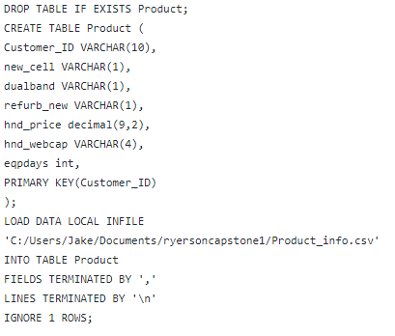
Loading to AWS MySQL Cloud Server
Step 1
Step 2
Step 3
Step 4
Step 5
Grouped Variables into Tables with R
Billing (avg charge, overages)
Customer (area, active subscribers)
Service (dropped calls, data calls)
CustServ (avg mins, num calls)
Operations (assorted usage in mins)
Product (refurbished, age)
Uploaded to AWS using MySQL Workbench

Slide 7
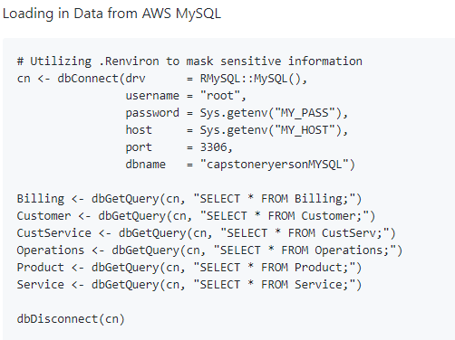
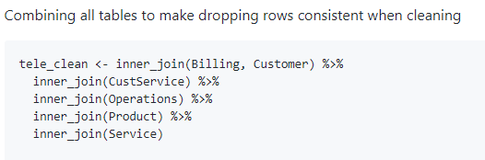
Pulling from AWS MySQL Cloud Server
Step 1
Step 2
Step 3
Step 4
Step 5
Full R Markdown Here

Slide 8
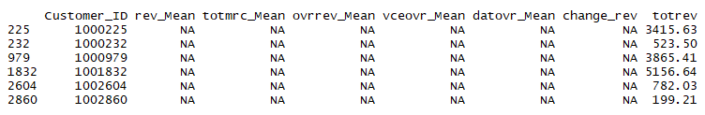
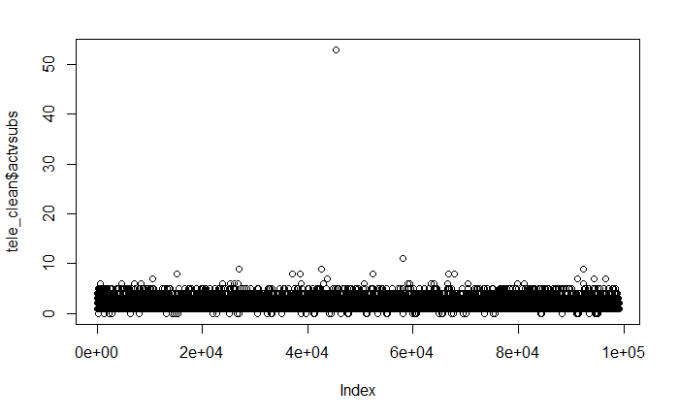
Cleaning in R
Step 1
Step 2
Step 3
Step 4
Step 5
NA Values
Dropped Rows
Measure of Central Tendency
Dropped Variables
Extreme Values
Binned NA into UNKWN
Factored Categoricals
Full R Markdown Here
Notes:
Missing multiple values
Insert median where fit since my distributions were all skewed
Dropped too many NA, beyond the scope of the project, or had low information
Dropped to prep for outliers

Slide 9
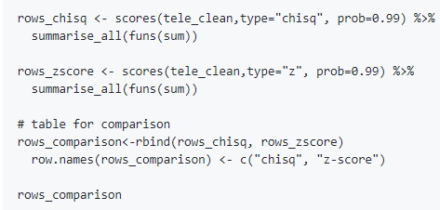

Dimensionality Reduction
Step 1
Step 2
Step 3
Step 4
Step 5
Rows
Dropping NA
Removing Extreme Values
Drop Outliers
Normalize
99,108 into 78,245 rows
Full R Markdown Here
Notes:
Z score and chi-square in 99 confidence, box below shows the counts per variable,
i went with z-scores as I’d normalize my data based on z-scores and
reduced my rows by nearly 20,000

Slide 10
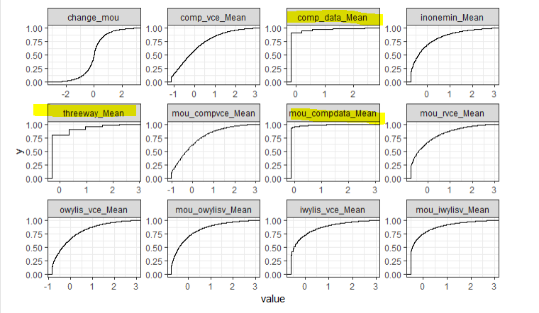
Dimensionality Reduction
Step 1
Step 2
Step 3
Step 4
Step 5
Numeric Variables
Near-Zero Variance
Multicolinearity
Categoricals
Information Gain
Boruta Permutation
Notes:
they have very few unique values relative to the number of samples and the ratio of the frequency of the most common value to the second most common value is large
ECDF, top-left is a normal distribution, low variances are highlighted in yellow

Slide 11
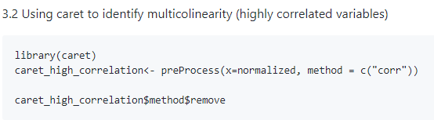
Dimensionality Reduction
Step 1
Step 2
Step 3
Step 4
Step 5
Numeric Variables
Near-Zero Variance
Multicolinearity
Categoricals
Information Gain
Boruta Permutation
Notes:
If two variables have a high correlation,
the function looks at the mean absolute correlation of each variable and removes the variable with the largest mean absolute correlation, the cumulative average of correlation variance

Slide 12
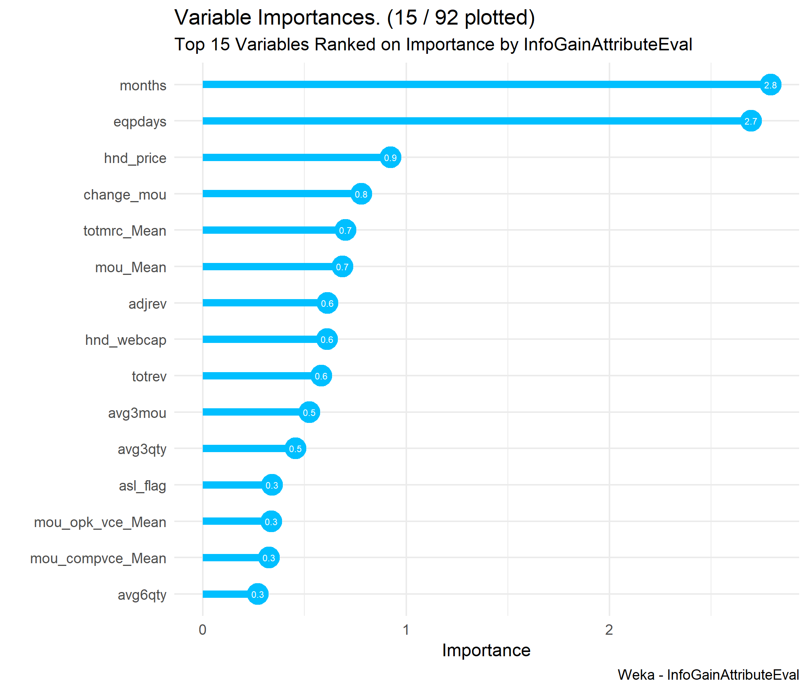
Dimensionality Reduction
Step 1
Step 2
Step 3
Step 4
Step 5
Numeric
Near-Zero Variance
Multicolinearity
Categorical
Information Gain
Boruta Permutation
Notes:
If it had an arbitrary 0.002 infogain, i dropped it.

Slide 13
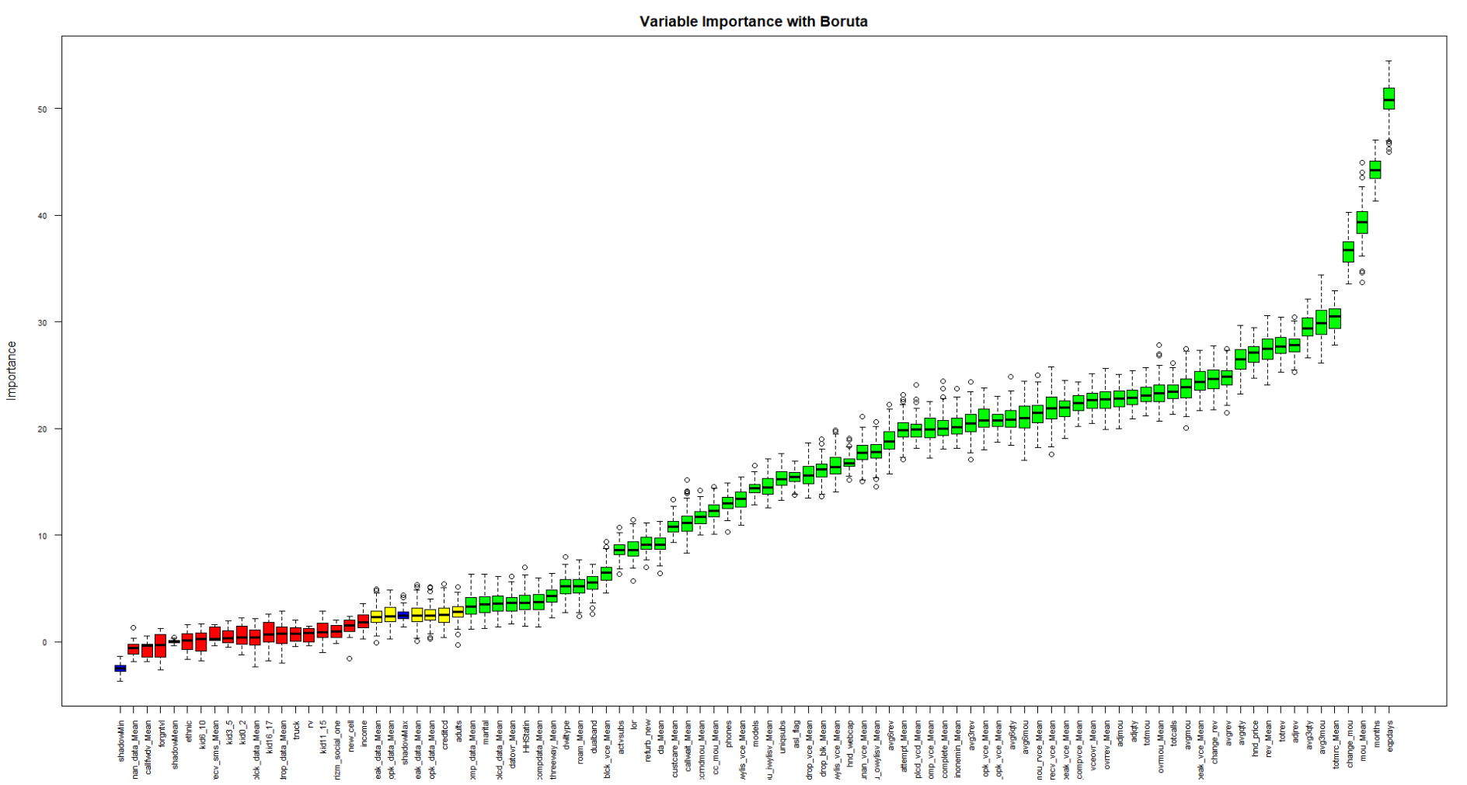
Dimensionality Reduction
Step 1
Step 2
Step 3
Step 4
Step 5
Numeric Variables
Near-Zero Variance
Multicolinearity
Categoricals
Information Gain
Boruta Permutation
93 to 50 variables
Notes:
Builds Random Forests and uses backwards elimination, removing variables which are confirmed as unimportant, starting at to progressively eliminate irrelevant features

Slide 14
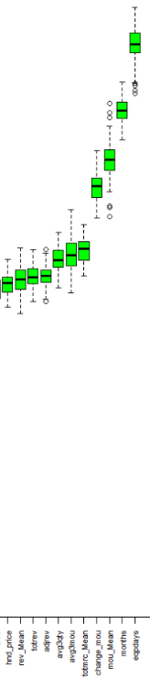
Looking at trends in the data off information from InfoGain and Boruta

Slide 15
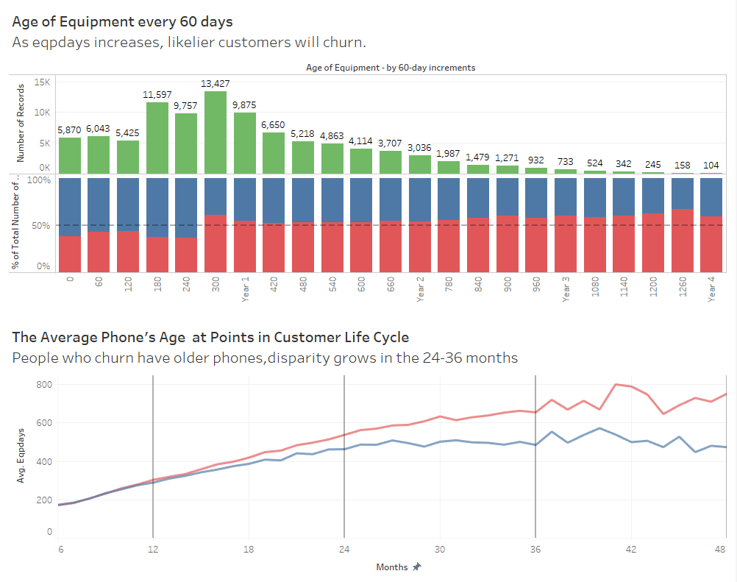
Investigating Strong Predictors for Marketing
Product Age
(eqpdays)
Product Cost
(hnd_price)
Product Usage
(change_mou)
Notes:
Idea: Trade In Rebate

Slide 16
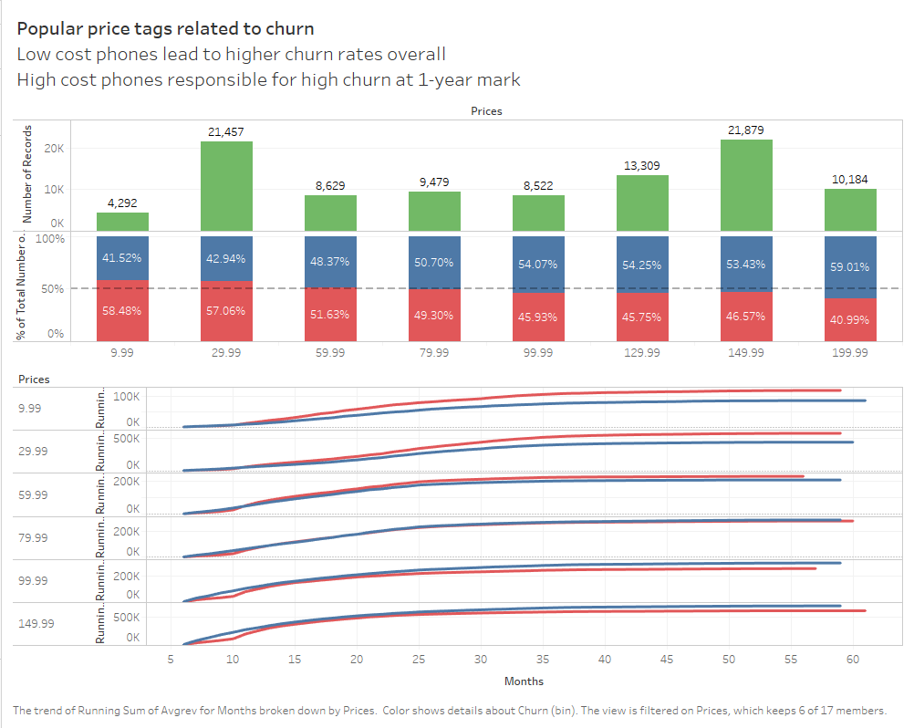
Investigating Strong Predictors for Marketing
Product Age
(eqpdays)
Product Cost
(hnd_price)
Product Usage
(change_mou)
Notes:
Idea: Get them to buy better phones

Slide 17
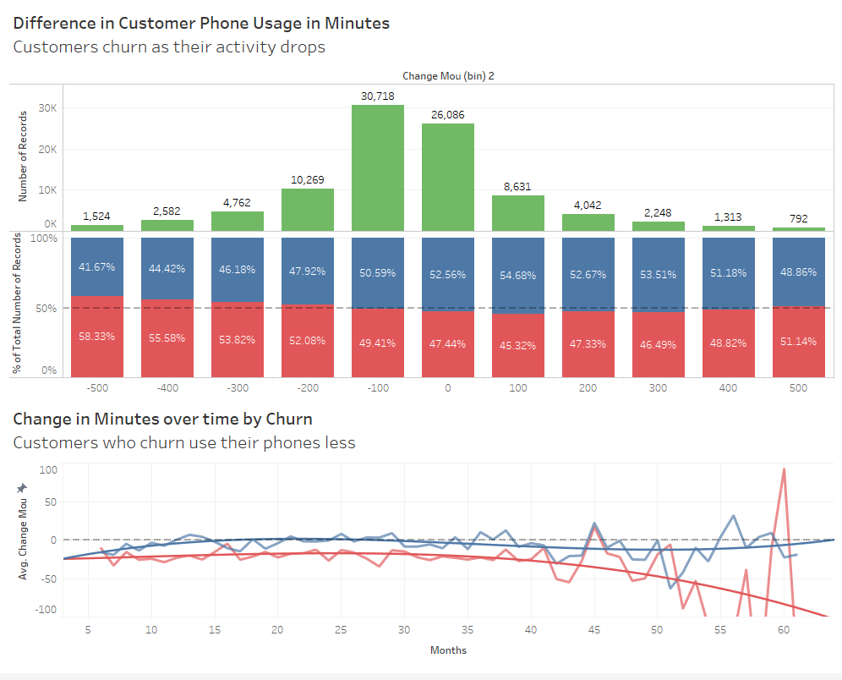
Investigating Strong Predictors for Marketing
Product Age
(eqpdays)
Product Cost
(hnd_price)
Product Usage
(change_mou)
Jake’s Public Tableau
Notes:
Idea: offer 1-year of free Spotify or Data Plan to face-time

Slide 18
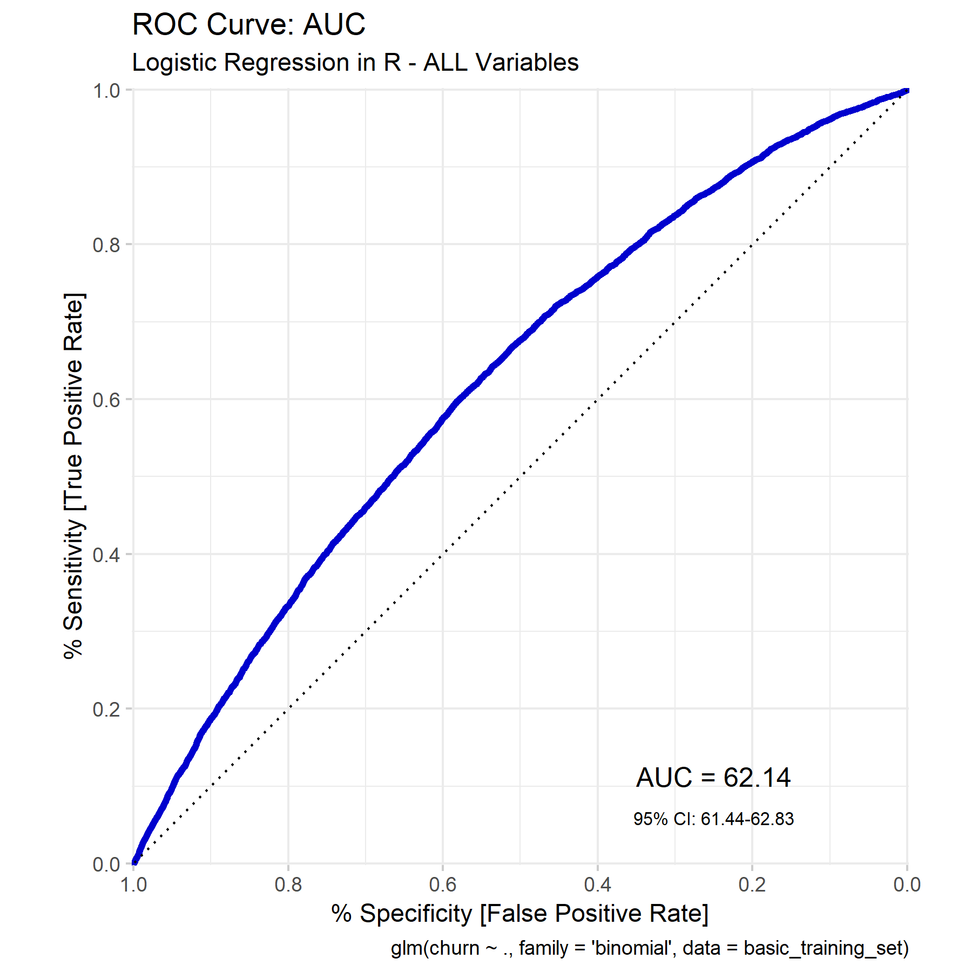
Models
Step 1
Step 2
Step 3
Step 4
Step 5
The Model to Beat:
Logistic Regression
tele_clean.csv
93 vars, 99,108 rows

Slide 19
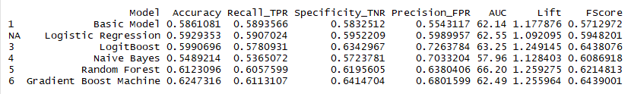
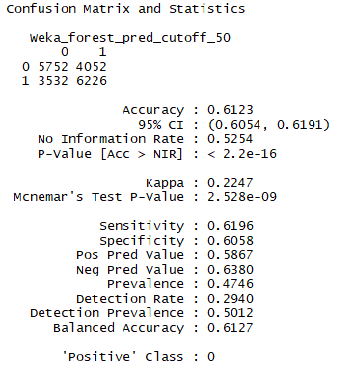
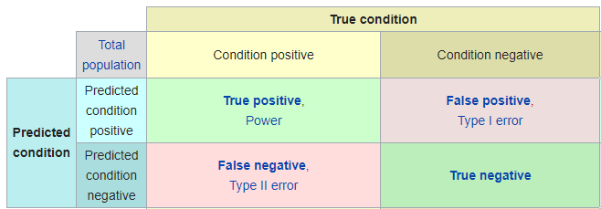
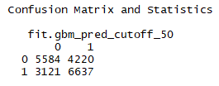
Models
Step 1
Step 2
Step 3
Step 4
Step 5
All model visuals found here
Notes:
Bottom 2, FPR/AUC/Lift

Slide 20
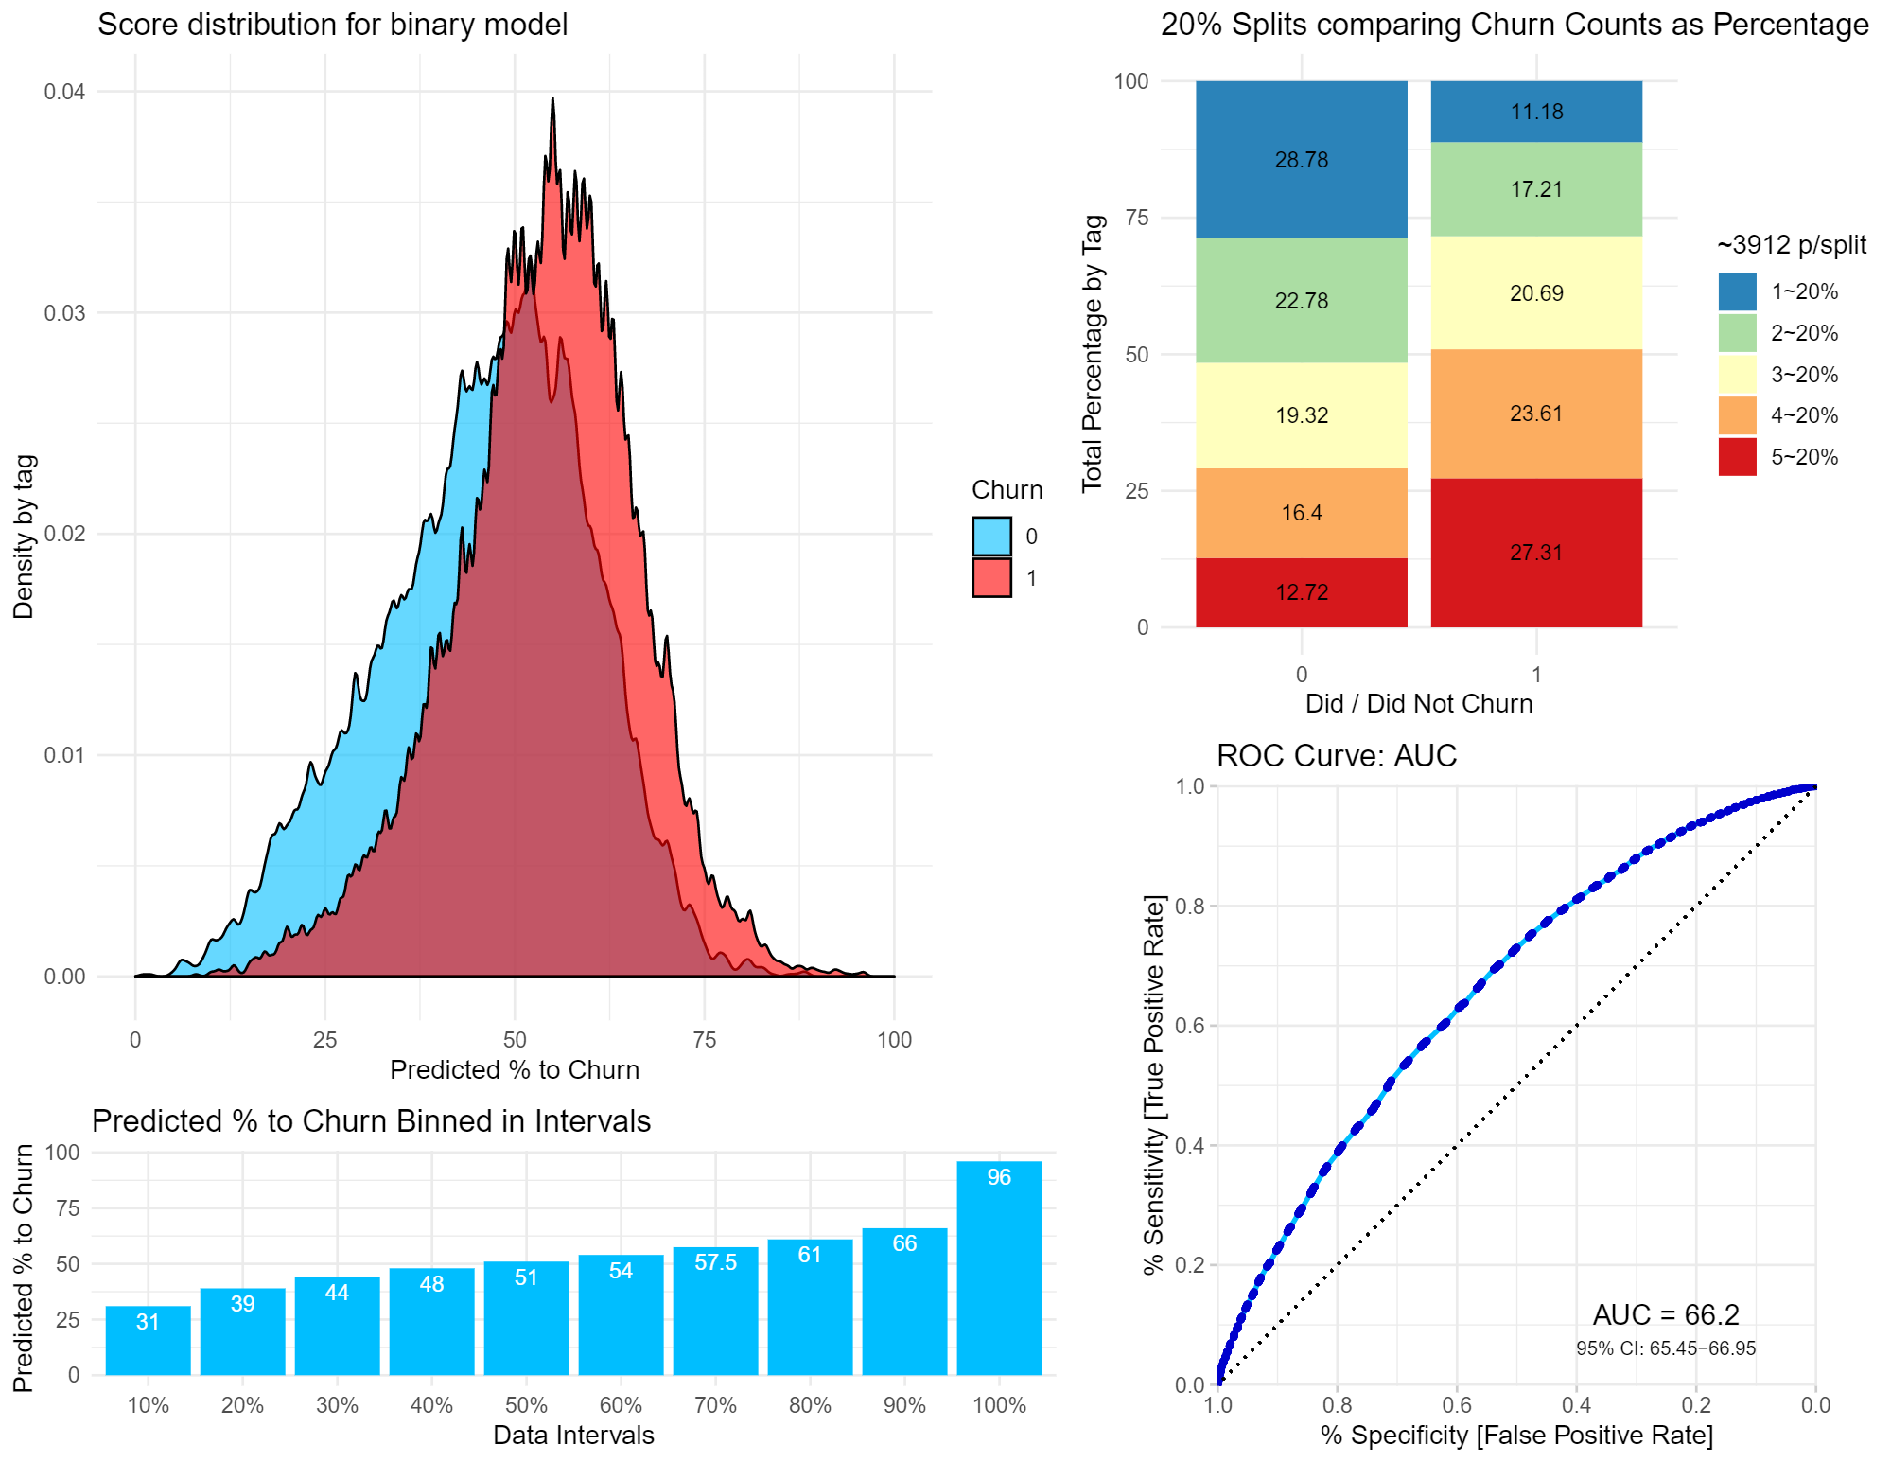
The Random Forest Model
Count of Churned vs
Stayed in 20% splits
Density of
Prediction
Distribution
AUC
Average
Prediction
every 10%
Notes:
Density can see the tails for false positives and false negatives
Also top-right, imagine was flipped on its side and two smallest chunks are the FP/FN
Bins show the average prediction at each 10%
AUC is split in classes / clusters

Slide 21
Churn Management Program
Step 1
Step 2
Step 3
Step 4
Step 5
Target: Customers Predicted to Churn > 70% (~5% of our Customer Base)
Goal: 30% success rate
Lifetime Value of Customer (LVC):
Light Medium Heavy
1500 2500 4000
Offer: $50 rebate on Mobile Data ($10 next 5 months)
Cost to contact: 50 cents

Slide 22
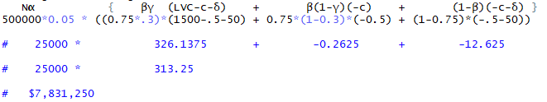
Churn Management Program
Step 1
Step 2
Step 3
Step 4
Step 5
The Churn Management Program is projected to retain $7,831,250 from a sample of 500,000 customers when offering a $50 rebate at 50c cost to communicate to the 5% likeliest-to-churn customer as predicted by our Random Forest Model at a 30% success rate.
Notes:
The first term within the brackets reflects profit contribution among the βγ fraction of
contacted customers who are would-be churners and decide based on the incentive to stay
with the company. The firm retrieves their lifetime value at a cost of c+δ.
The second term within the brackets reflects profit contribution among the β(1-γ) fraction of
contacted would-be churners who do not accept the offer and leave the firm. The loss
from these customers is c, since they do not accept the offer.
The third term within the brackets reflects profit contribution among the (1-β) fraction of contacted customers who
are not would-be churners. We assume these customers accept the offer and cost the
company c+δ. These customers represent the wasted money for the firm. They were not
going to churn yet the firm spent incentive money on them.
Those in this range of predictions are expected to churn at a rate of 75% at a total value of $27,178,125 where if we are 30% successful, we can retain $8,153,438 of that money -- however, once we factor in punishments for marketing to customers who do not accept the offer and leave, as well as customers who were going to stay and accepted the offer anyway, it rounds the revenue down to $7,831,250. This is why we value a model with high Lift and low FPR, so we can avoid marketing to people who were going to stay.

Slide 23
Further Work
To Do with Statistics:
Create table for 10%,30%,50% success at 1500,2500, 4000 values
Survival Analysis to predict WHEN people churn to aid with LVC estimation
Find the Gain Ratio which is the dollars gained per 0.1 in Lift increased
10-Fold Cross Validation to prove models are statistically better than another
More To Do with Marketing:
Mark the targeted customers from the churn program with a binary variable to help track their retention and trends
Develop a marketing campaign tailored to address the poor trends developing in these 5% -- closely related to the EDA visuals
Notes:
http://citeseerx.ist.psu.edu/viewdoc/download?doi=10.1.1.489.5495&rep=rep1&type=pdf

Slide 24
Programs
Used
AWS - MySQL Cloud Server
MySQL Workbench
RStudio
Weka
Tableau

